Slide 1
PreGAN
Preemptive Migration Prediction Network
for Proactive Fault-Tolerant Edge Computing
Reporter:黃一恩
Advisor : 曾學文

Slide 2
Outline
Introduction
Methodology
Experiments
Related work
Conclusion

Slide 3
Introduction
Building a fault-tolerant edge system that can quickly react to node overloads or failures is challenging
🞑 Unreliability of edge devices
🞑 Strict service deadlines of modern applications
Unnecessary task migrations can stress the system network so
need for a smart and parsimonious failure recovery scheme
🞑 PreGAN , AI model using a Generative Adversarial Network (GAN) to predict preemptive migration decisions for proactive fault-tolerance in containerized edge deployments.

Slide 4
Introduction
Existing solutions
🞑 A popular method is to provide node redundancy to avoid the
crippling downtime of an edge element
🞑 However, with the increasing number of edge devices,
having redundancy for each node is not feasible
🞑 Another way is to replicate the running instance of a task on a separate node
🞑 This is not ideal for resource-constrained edge devices as it makes
them more susceptible to resource contention and faults

Slide 5
Introduction
Background and new insights.
🞑 To be able to predict an appropriate preemptive migration
decision, it is crucial to accurately detect, diagnose and
classify faults in an online fashion
🞑 One way to achieve this is to create a deep generator model Generative Adversarial Networks(GANs) have been shown
to be very successful in this as they can reduce prediction
errors and provide us with a robust anomaly prediction framework

Slide 6
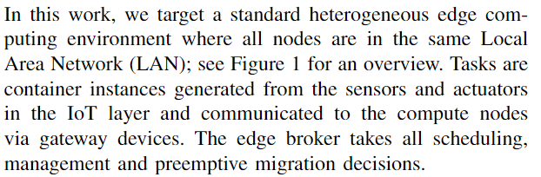
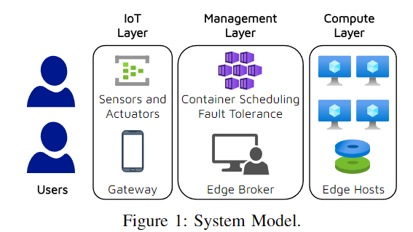
METHODOLOGY
System Enviroment and Problem Formulation

Slide 7
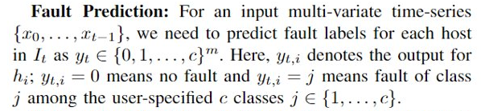
METHODOLOGY
System Enviroment and Problem Formulation
🞑 Assume there are m number of host machines in
the fog resource denote them as H = {h1,...,hm}.
🞑 Assume a scheduler is already present in the broker.
The t-th interval is denoted as and the scheduling decision and
host characteristics at this interval are denoted as St and xt ∈ IRm×n (each host has n features).
🞑 The time-series {x0,...,xt−1}is denoted as Tt

Slide 8

METHODOLOGY
System Enviroment and Problem Formulation
🞑 Assume there are m number of host machines in
the fog resource denote them as H = {h1,...,hm}.
🞑 Assume a scheduler is already present in the broker.
The t-th interval is denoted as and the scheduling decision and
host characteristics at this interval are denoted as St and xt ∈ IRm×n (each host has n features).
🞑 The time-series {x0,...,xt−1}is denoted as Tt

Slide 9
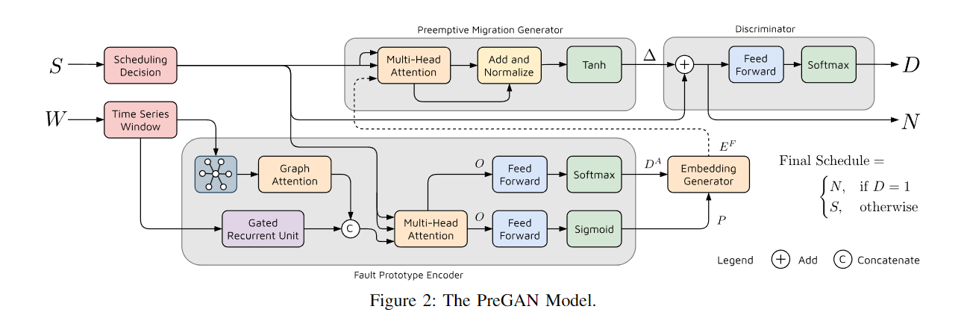
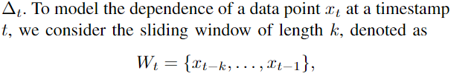
METHODOLOGY
The GAN model

Slide 10
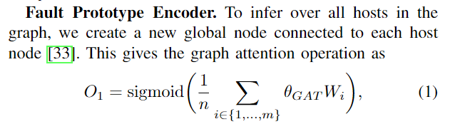
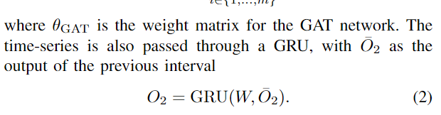
METHODOLOGY

Slide 11
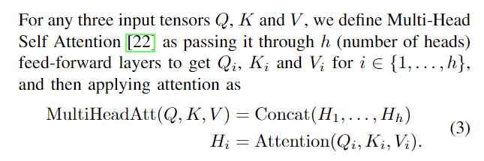

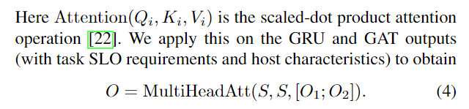
METHODOLOGY

Slide 12
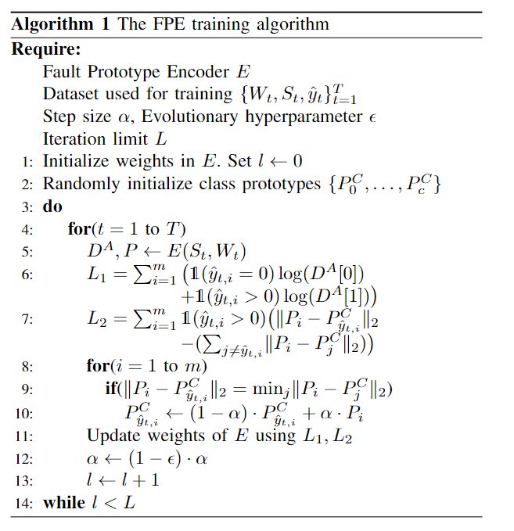
METHODOLOGY

Slide 13
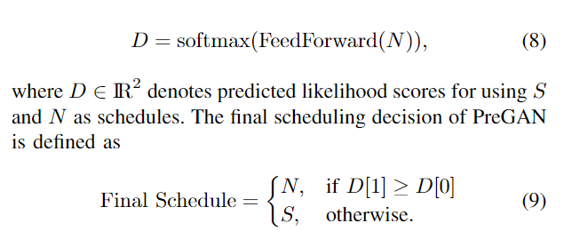
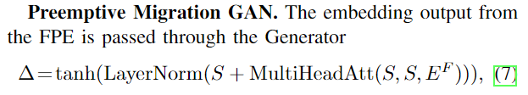

METHODOLOGY

Slide 14
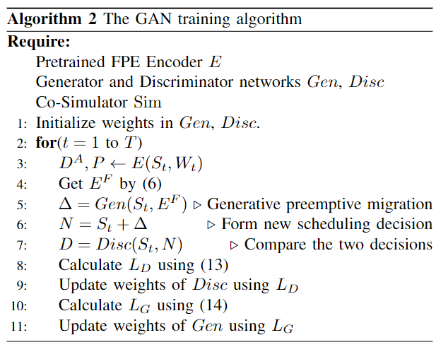

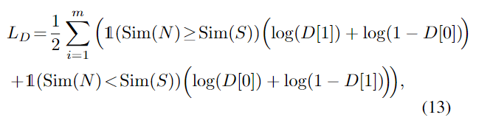

METHODOLOGY
We denote the co-simulated QoS scores by Sim(S) and Sim(N).

Slide 15
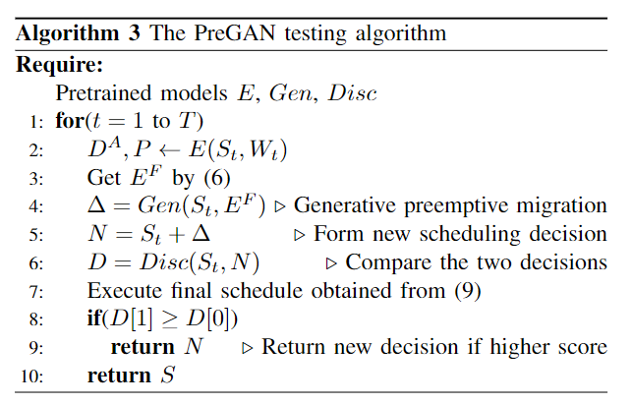
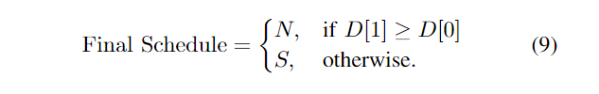
METHODOLOGY

Slide 16
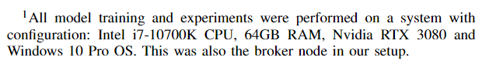
EXPERIMENTS
Enviroment setup.
🞑 Our evaluation testbed is a cluster with 16 Raspberry Pi nodes.
Our cluster contains 8 nodes with 4-GB RAM and another 8 with 8-GB RAM
🞑 We run all experiments for 100 scheduling intervals
with each interval being 300 seconds , giving a total experiment time of 8 hours 20 minutes.

Slide 17
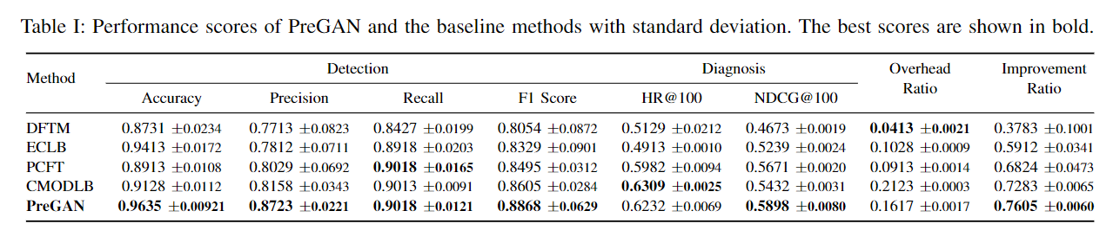
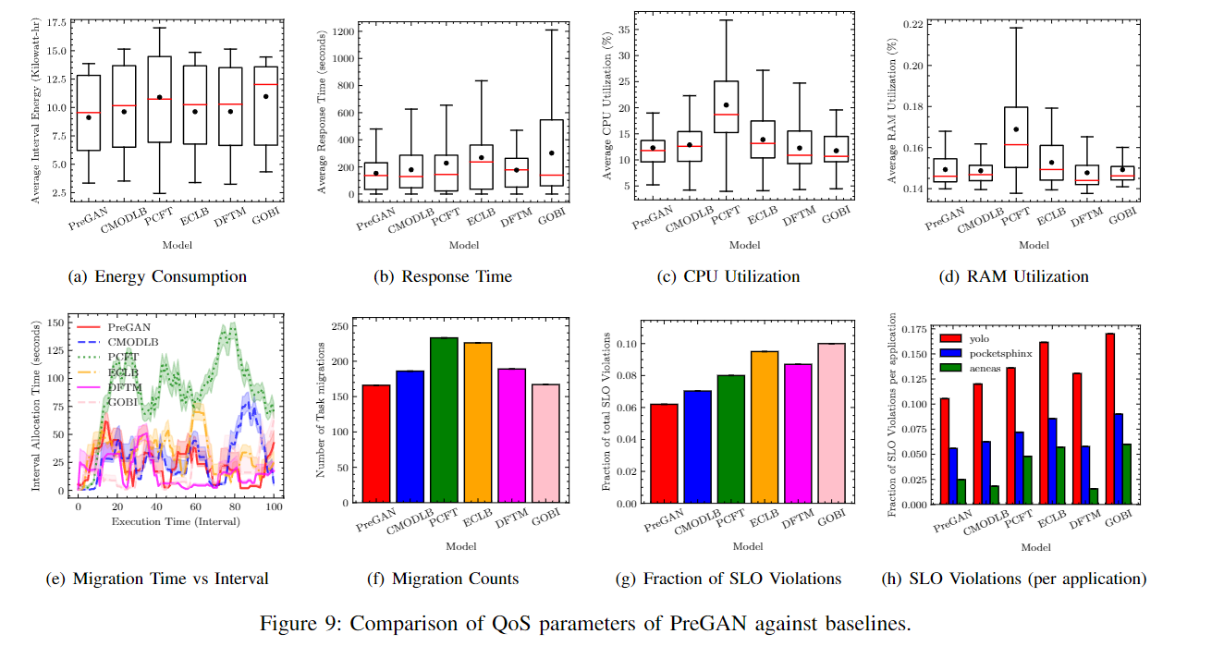
EXPERIMENTS

Slide 18
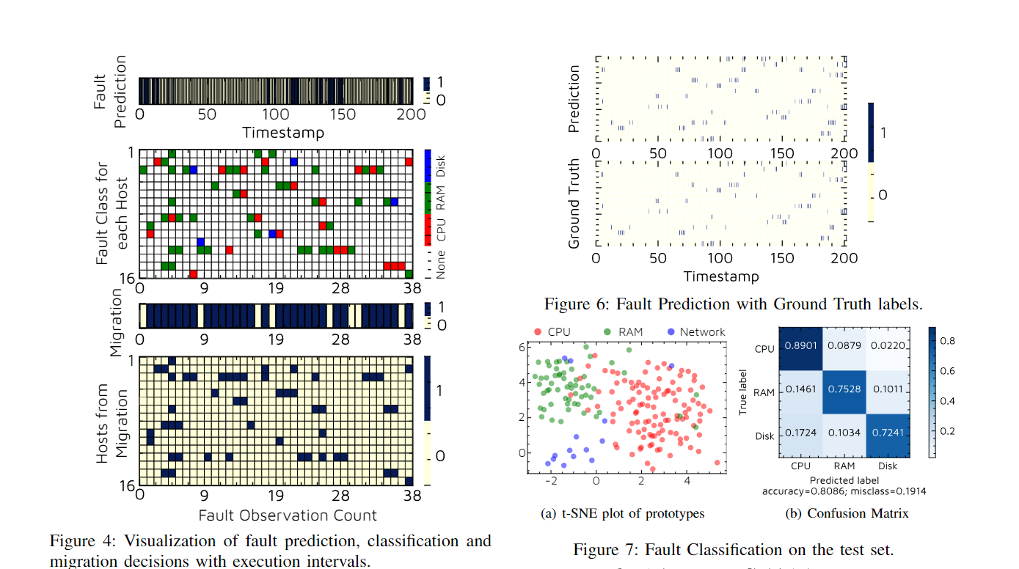
EXPERIMENTS

Slide 19
Related work
Dynamic Fault Tolerant Migration (DFTM).
🞑 Is a recent method that uses an integer linear programming (ILP)
formulation to analyze workload traffic select the tasks running on the hosts that should be migrated and the target hosts for restoration
The Proactive Coordinated Fault Tolerance (PCFT)
🞑 Method uses Particle Swarm Optimization (PSO) to reduce the overall transmission overhead, network consumption and total execution time for a set of tasks

Slide 20
Conclusions
🞑 We have presented a preemptive migration prediction model (PreGAN) that can detect, diagnose and classify faults in edge computing environments
🞑 We now present some future directions for this work.
Due to difficulty in obtaining labeled data for training,
we propose to extend PreGAN to utilize unsupervised models .
🞑 Finally the current model assumes a master-slave design and we plan to explore extensions that allow us to deploy PreGAN in federated or serverless platforms with streaming tasks

